Slide 1

Portfolio Update
Week of 9/14/26

Slide 2
Presentation Outline
Overview of Mission and Objective
Portfolio Overview
Portfolio Analytics
Conclusion

Slide 3
Mission and Objective
This portfolio is created to analyze investment trends.
  I am not a financial advisor, investment guru, etc.
  I am not telling you which stocks to choose; I am analyzing a portfolio.

Slide 4
Portfolio Overview
8-stock portfolio
  Sectors: Banking, Insurance & Managed Healthcare, Technology, Food & Drug
Total cash at purchase: $100,000
Initial purchase date of stocks: January 2, 2026

Slide 5
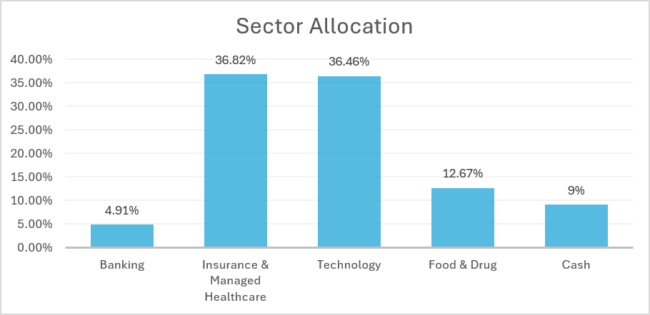
Portfolio Allocation
Highest asset allocation sector is in Insurance & Managed Healthcare
Individual Allocation located in the appendix

Slide 6
Portfolio Performance Overview
Portfolio value: $103,234.93
Cash: $ 9,424.05
YTD Return: 6.87%
No sales since January 2, 2026

Slide 7
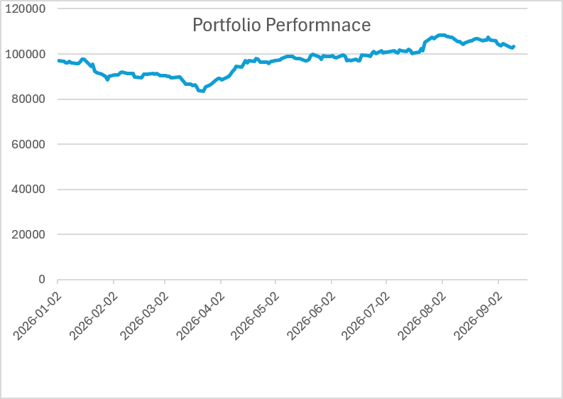
Portfolio Performance - Return
Since January 2, 2026, the return has steadily increased and sits at 6.87%.

Slide 8
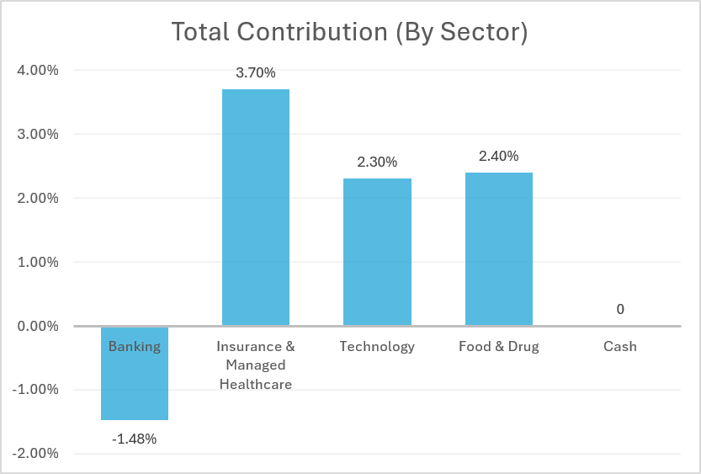
Portfolio Contribution - Return
Total Return: 6.87%
Banking sector has the lowest contribution.
Insurance & Managed Healthcare has the most contribution.
Individual Stock Contribution located in the appendix

Slide 9
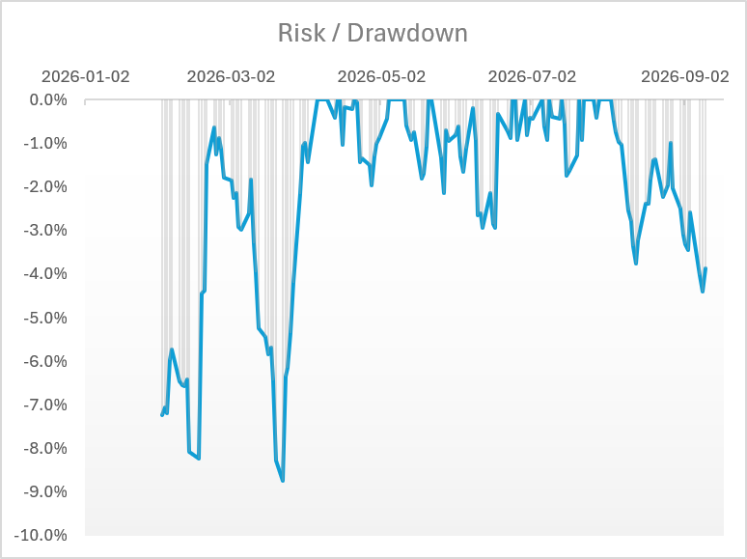
Portfolio Risk / Drawdown
Max drawdown is -8.75% with a 9-trading day recovery.

Slide 10
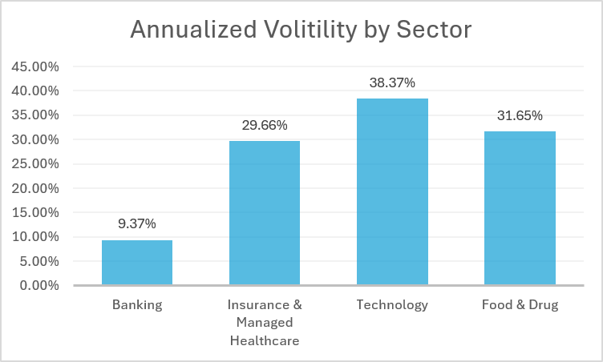
Annualized Volatility – By Sector
The highest volatility is in the technology sector.

Slide 11
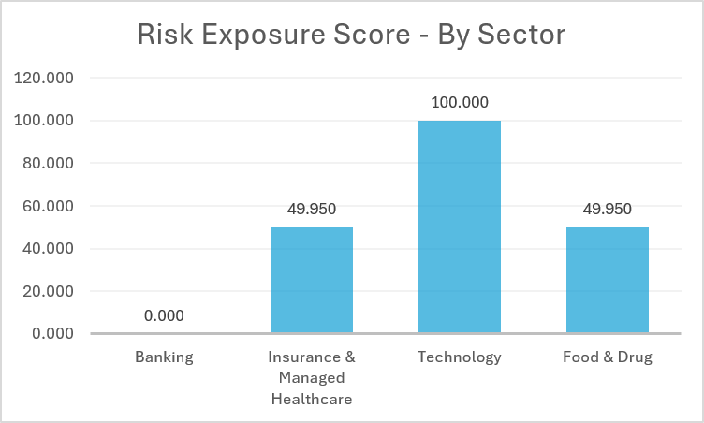
Risk Exposure Score
Measured using returns and volatility
Technology poses the greatest risk exposure in the portfolio
Banking allocation is 4.91% while I&M is 36.82%

Slide 12
Risk Exposure Score vs. Return
Technology pose the greatest risk exposure in the portfolio while Insurance & Managed Healthcare show the greatest return

Slide 13
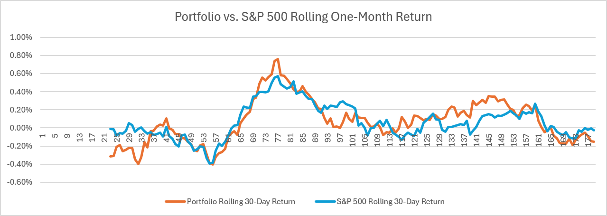
Benchmark Comparison
Portfolio does not perform as well as the S&P 500 in return or risk metrics.

Slide 14
Portfolio Review
Allocation
  Highest Allocation: Insurance & Managed Healthcare (36.82%)
Performance
  YTD Portfolio Return: 6.87%
  Insurance and Managed Healthcare has the highest return to contribution.
Risk
  Technology carries the highest risk.

Slide 15
Appendix

Slide 16
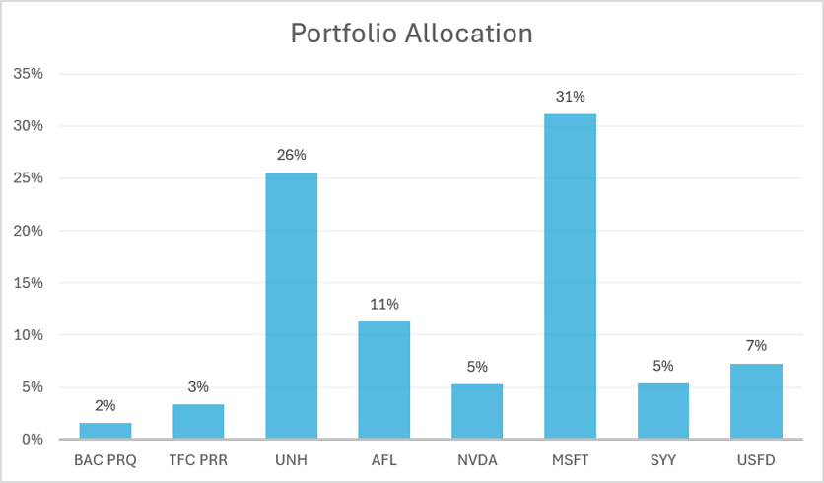
A: Portfolio Allocation – Specific Stocks

Slide 17
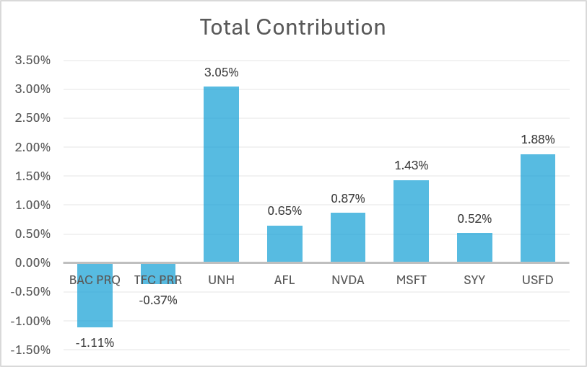
B: Contribution – Specific Stocks

